Slide 1
Topic 2 slides Ask Weber
Weber Liu

Slide 2
Topic 2
Cell structure

Slide 3
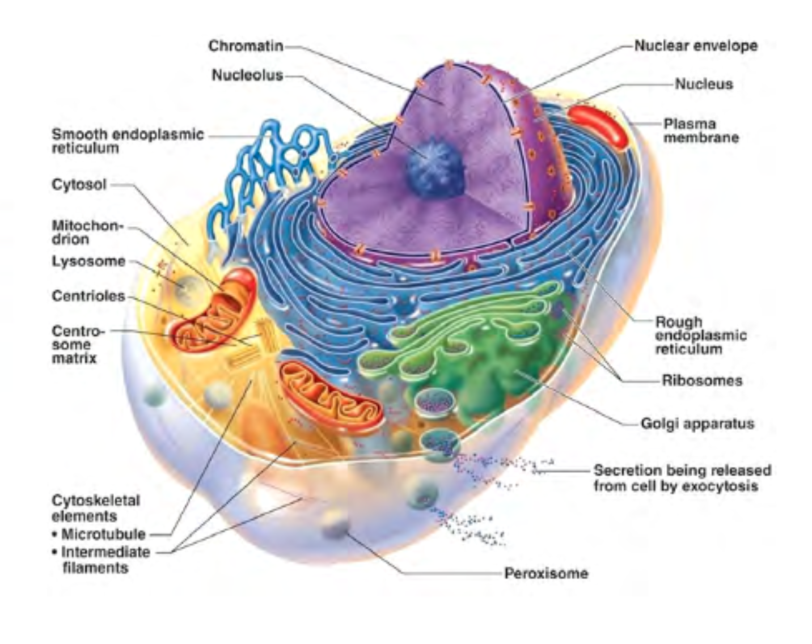
Lecture 2 – Cell components
What is the function of the RER?
What is the function of the SER?
What is the order in which DNA is converted into proteins?
What cell component/organelle is involved in the destruction of waste
Is the cell to the left a eukaryotic or prokaryotic cell?

Slide 4
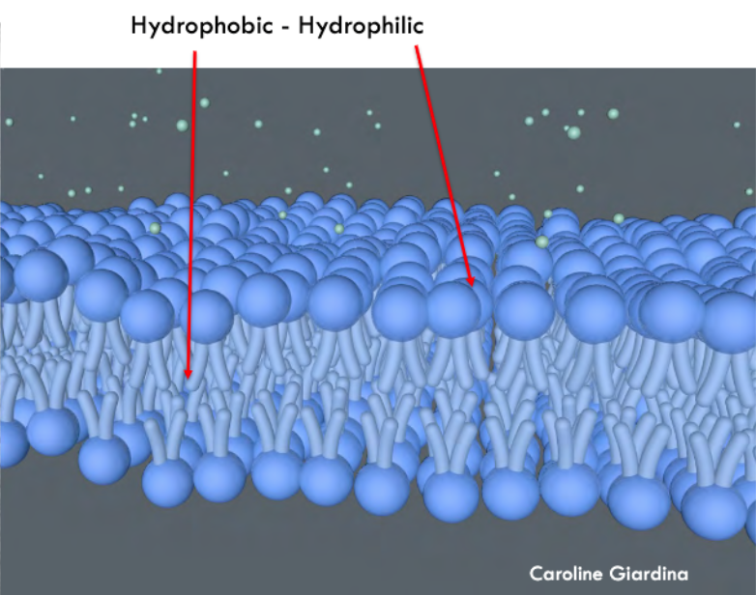
Lecture 2 – Cell components
In a phospholipid bilayer, is the hydrophobic layer in the inside (sandwiched in the middle) or the outside (doing the sandwiching)?
What substances are the lipid bilayer NOT permeable to?

Slide 5
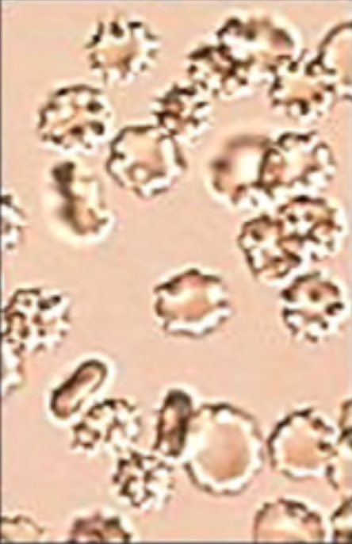
Lecture 2 - Tonicity
In the image to the left, red blood cells have been placed in a solution. Is the solution hypertonic, isotonic or hypotonic compared to the red blood cells?
Define hypertonic, isotonic and hypotonic

Slide 6
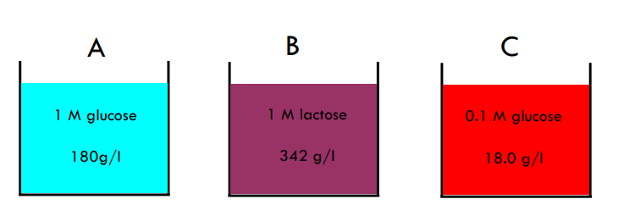
Explain the process of osmosis
Explain osmosis
A semipermeable membrane is placed between
A and B
B and C
A and C
Explain which direction osmosis would occur

Slide 7
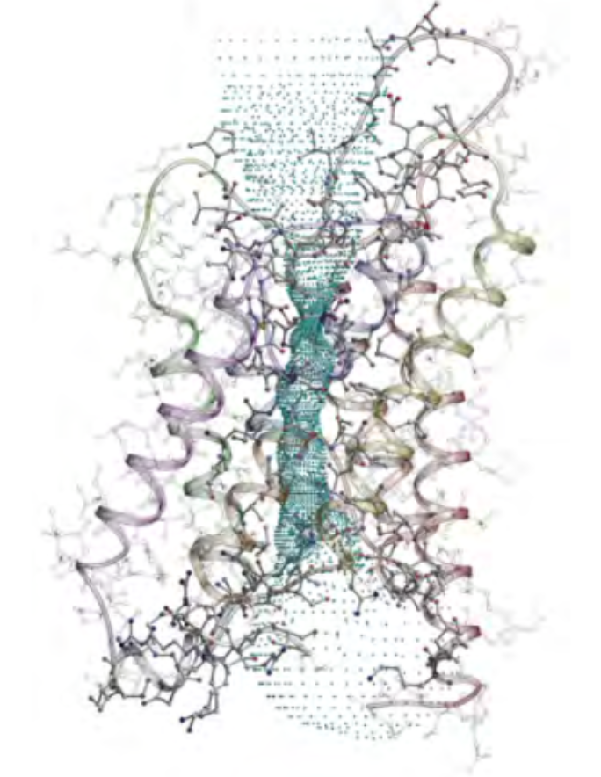
Lecture 2 – ion movement
In the disorder known as SIADH (Syndrome of Inappropriate ADH), a hormone (ADH) is released in excess. At the kidney, ADH plays a role in upregulating AQP2 (Aquaporin). This process tends to concentrate the urine. Describe in as much detail as possible what you know about Aquaporin.
Is Aquaporin an example of facilitated diffusion or active transport?

Slide 8
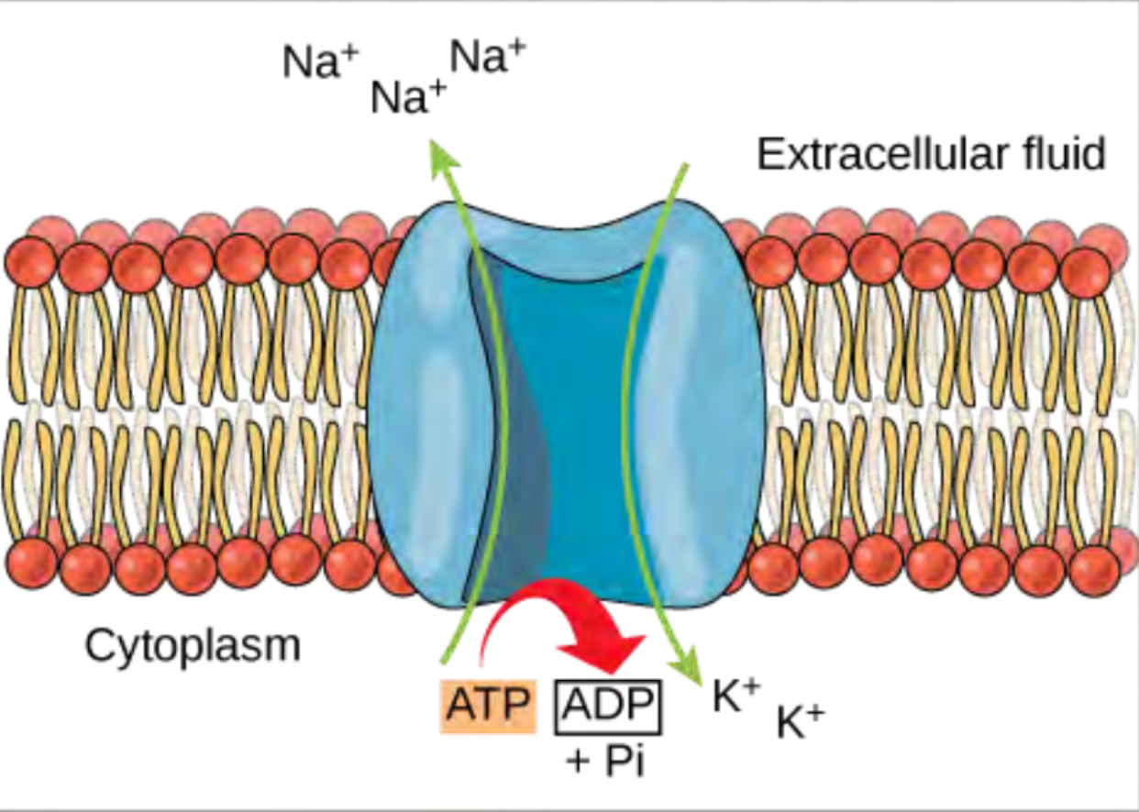
Lecture 2 - NKA
In most cells, a membrane potential is maintained at the basolateral surface typically by a Na+-K+-ATPase. This will pump 3 Na+ ions out of the cell and 2 K+ ions into the cell, whilst using up an ATP molecule. Is this an example of active or passive transport?
Explain how this transporter results in a positive/negative membrane potential for the cell

Slide 9
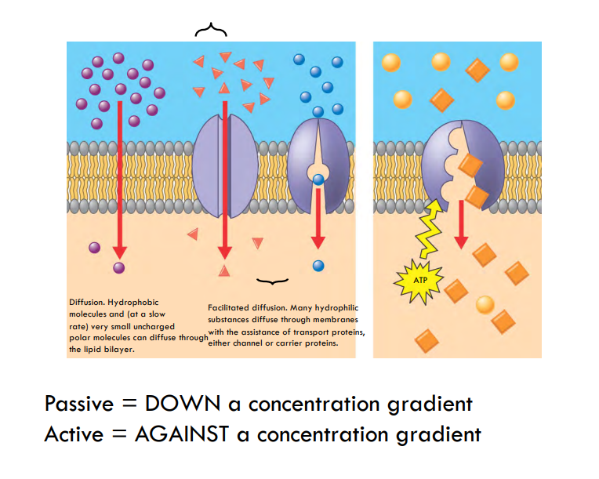
Active vs passive transport
Both active transport and facilitated diffusion require ion channels. Explain their differences

Slide 10
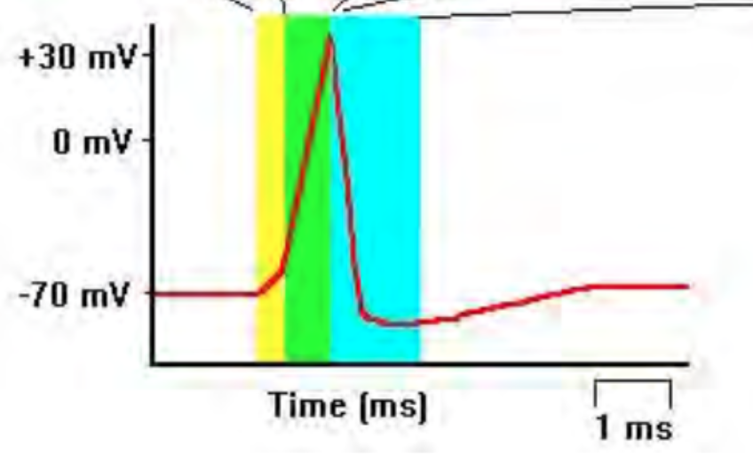
Lecture 2 – Action potential
In the following AP diagram, explain
What channel(s) open in the yellow
What channel(s) close in the yellow
What channel(s) open and close in the green
What channel(s) open and close in the blue
What component within the cell membrane insures a higher Na+ concentration intracellularly?

Slide 11
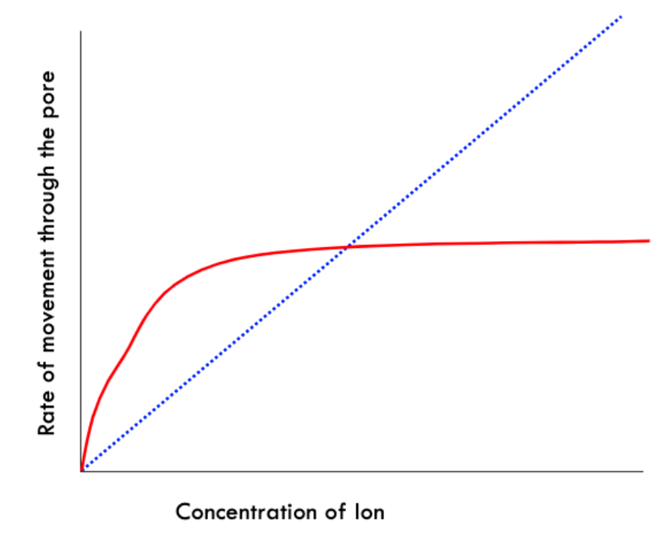
Lecture 2 – graph interpretation
Interpret the figure to the left (note the blue dotted line is just a diagonal line indicating this scale is linear).

